Slide 1
User Administration
Privileges

Slide 2
Create new User
CREATE USER saleh@localhost IDENTIFIED BY '00112233';

Slide 3
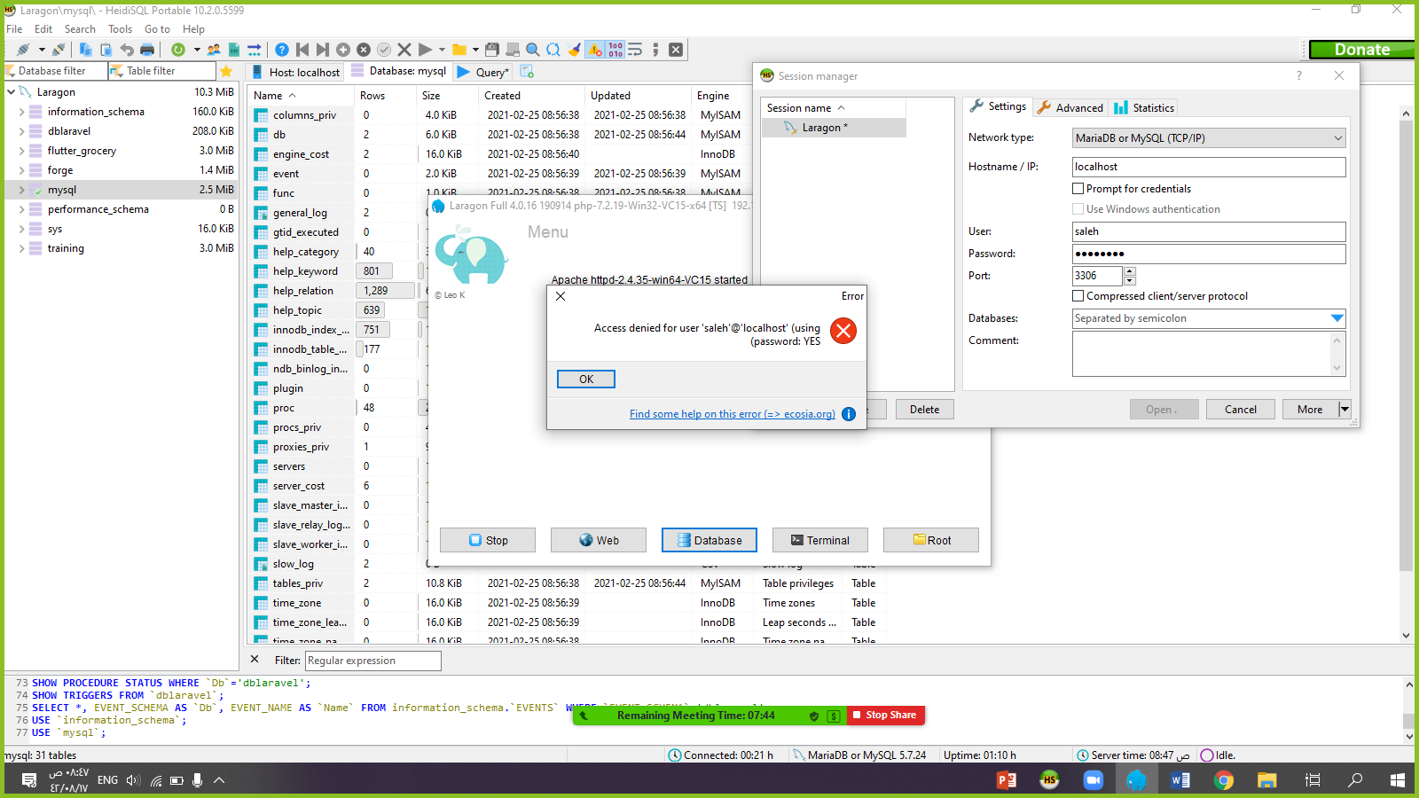
Try to connect with wrong password

Slide 4
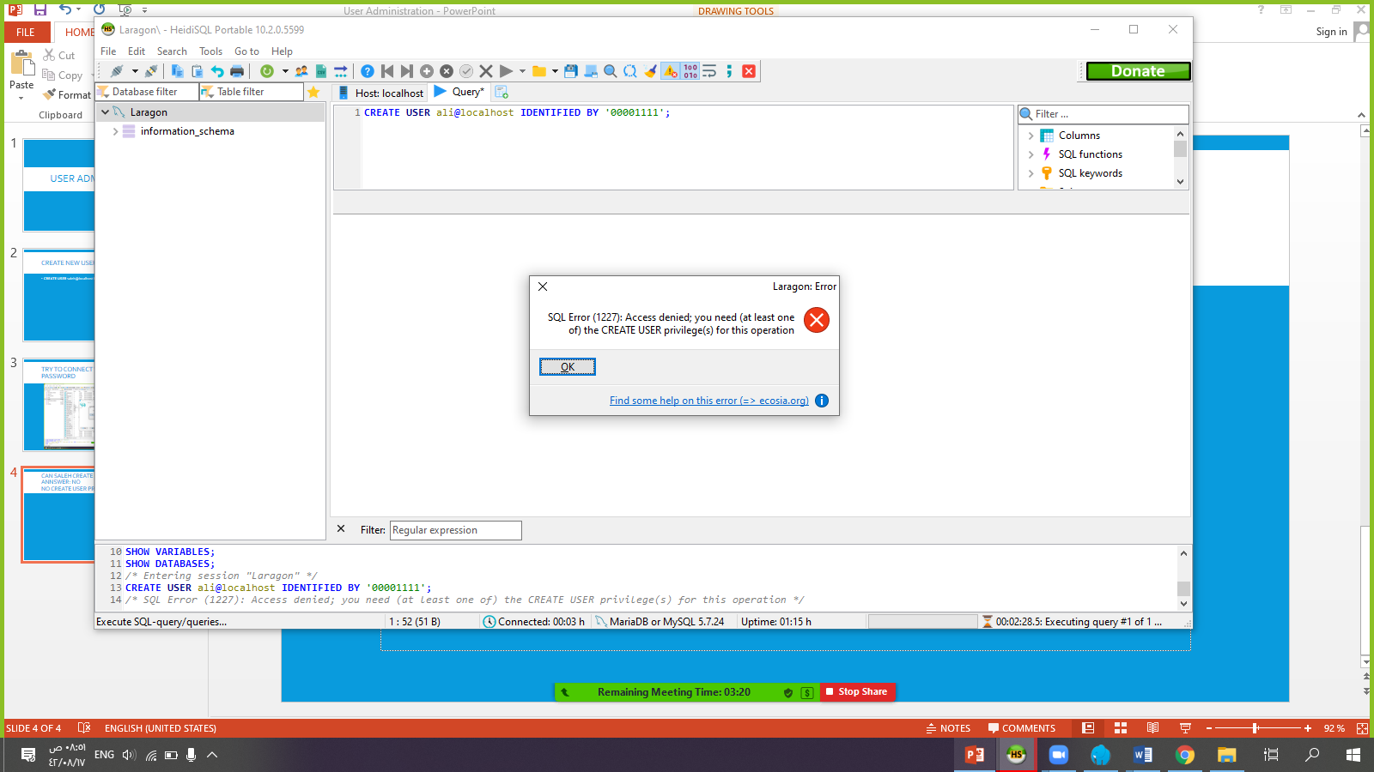
Can Saleh create user ? Answer: No No create user provileges

Slide 5
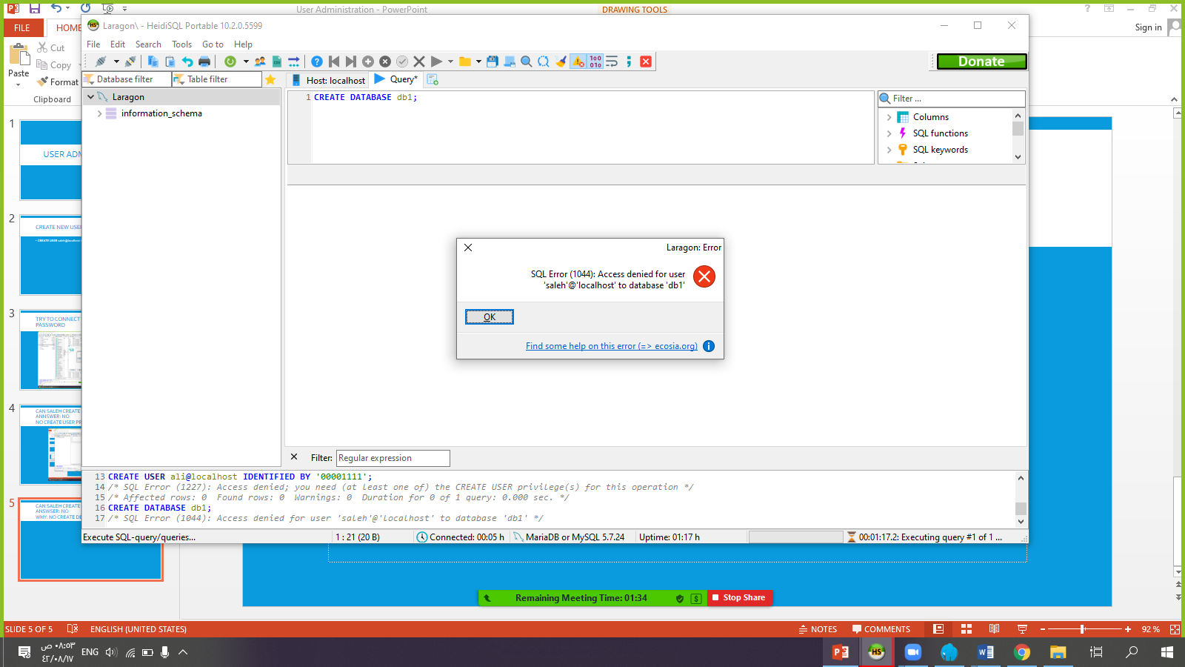
Can Saleh create databases ? Answser: No Why: no create db privilEges

Slide 6
RENAME USER
RENAME USER saleh@localhost TO user1@localhost;

Slide 7
Modify password
UPDATE mysql.user SET authentication_string=PASSWORD('00001111')
where user = 'user1'
AND HOST='localhost';
FLUSH PRIVILEGES;

Slide 8
Remove User
DROP user user1@localhost;

Slide 9
CREATE user saleh@192.168.1.100 IDENTIFIED BY '00001111'
CREATE user saleh@% IDENTIFIED BY '00001111'

Slide 10
grant create user on *.* to user1@localhost with grant option;

Slide 11
SHOW GRANTS FOR user1@localhost;

Slide 12
GRANT CREATE, DROP ON dblaravel.* TO sami@localhost;

Slide 13
GRANT SELECT ON dblaravel.* TO sami@localhost;

Slide 14
revoke SELECT ON dblaravel.* from sami@localhost;

Slide 15
grant SELECT ON dblaravel.users(NAME) to sami@localhost;

Slide 16
grant SELECT(name) ON dblaravel.users to sami@localhost;

Slide 17
GRANT ALL PRIVILEGES ON *.*
TO 'sami'@'localhost' IDENTIFIED BY '001122'
WITH GRANT OPTION;

